Slide 1
Bray Team Week 4 Update
Avery Haynes, Locke Lehmann, Travis Carlson, Cody Sims, Zachary Walker, Michael Hager
2/12/2024

Slide 2
Weekly Deliverables
Tasks | Lead | Percentage Done | Notes
Formulate experimental design for testing | Locke/Avery | 100% | Completed
Peer Evaluation | All | 100% | Completed
Set up sensors in valves/ actuator | Cody/Travis | 40% | Most supplies have arrived, started brainstorming sensor implementation.
Research data analysis methods | Michael | 100% | Have valid research for methods to analyze data with Raspberry Pi.

Slide 3
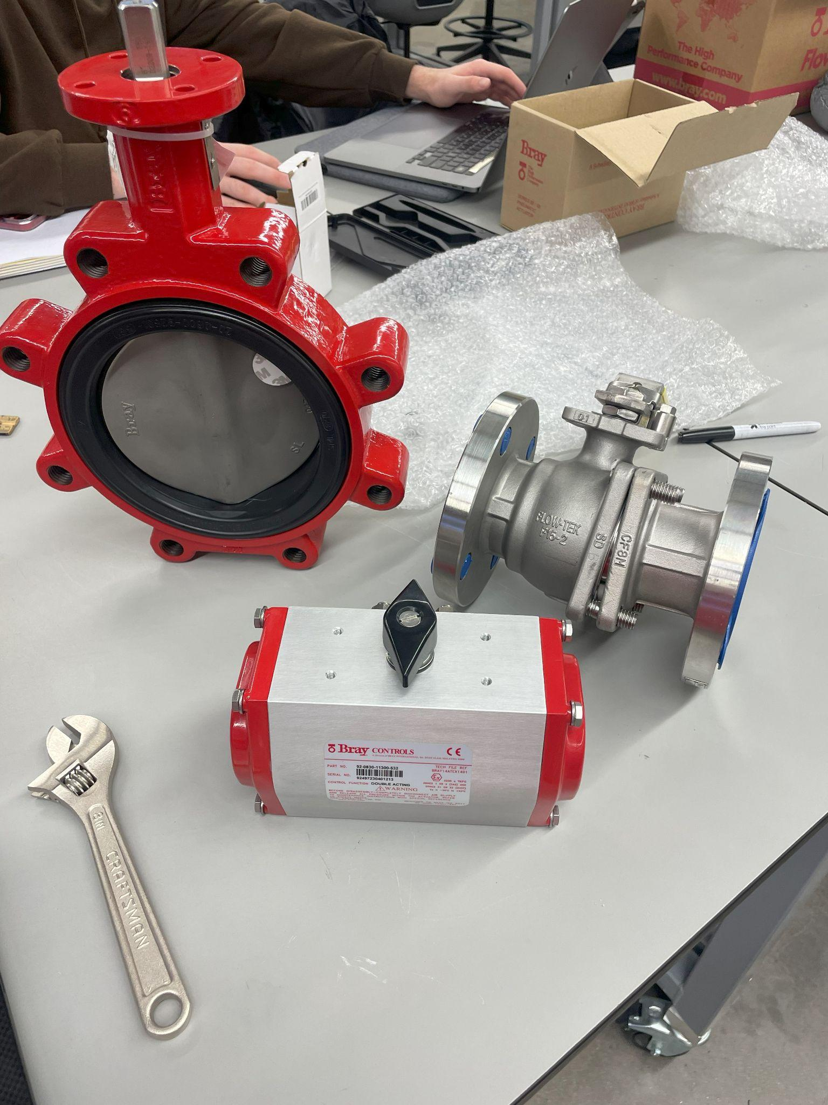
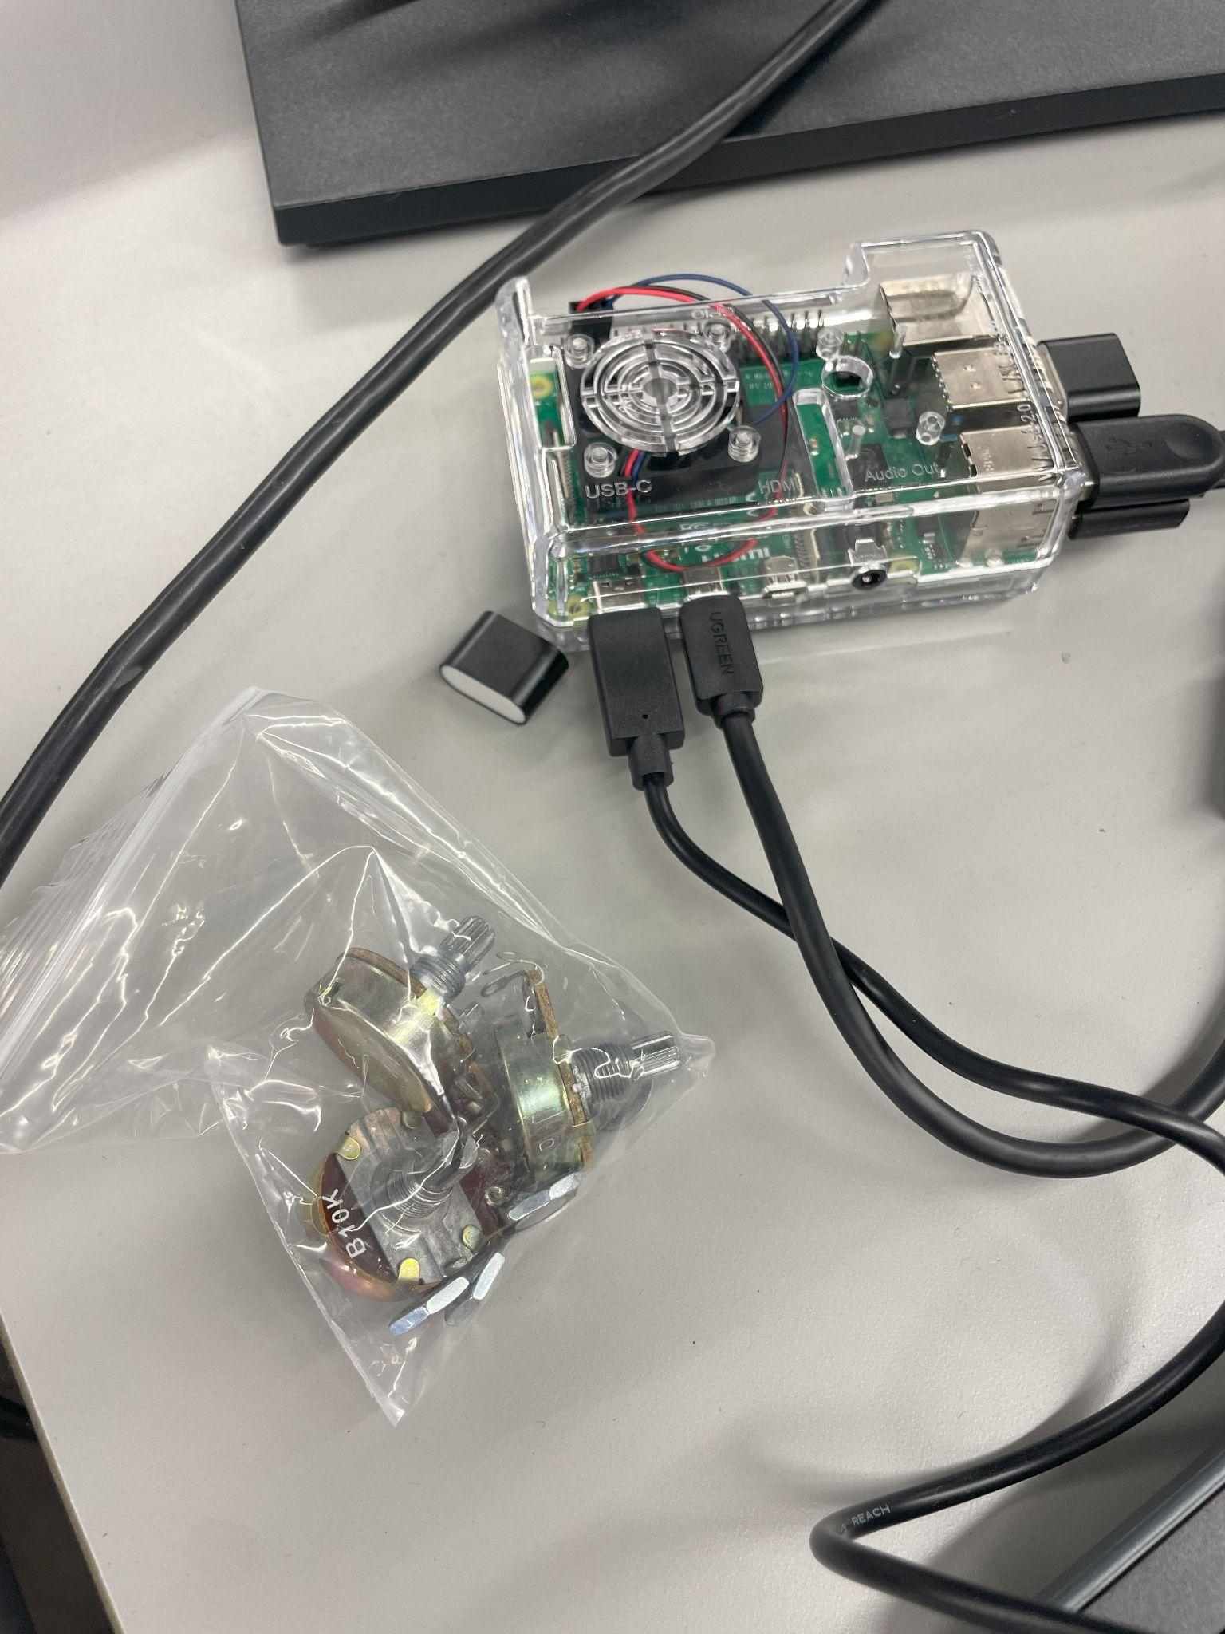
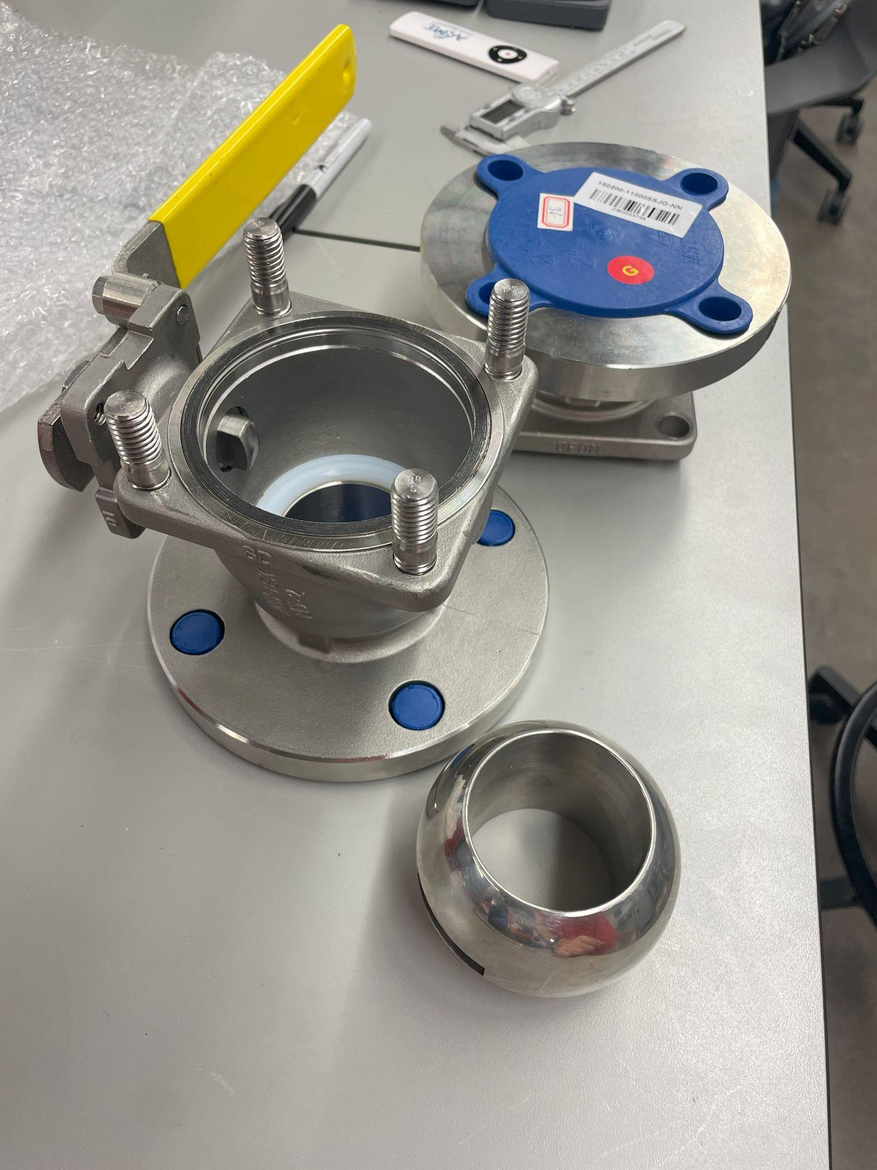
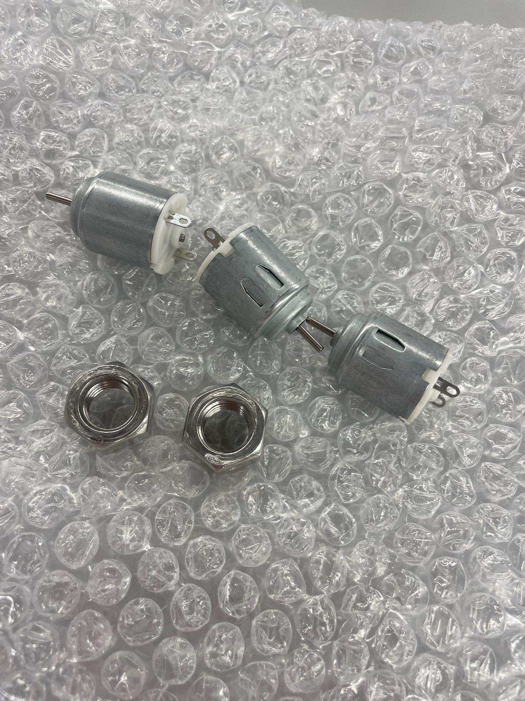
Part Inspection

Slide 4
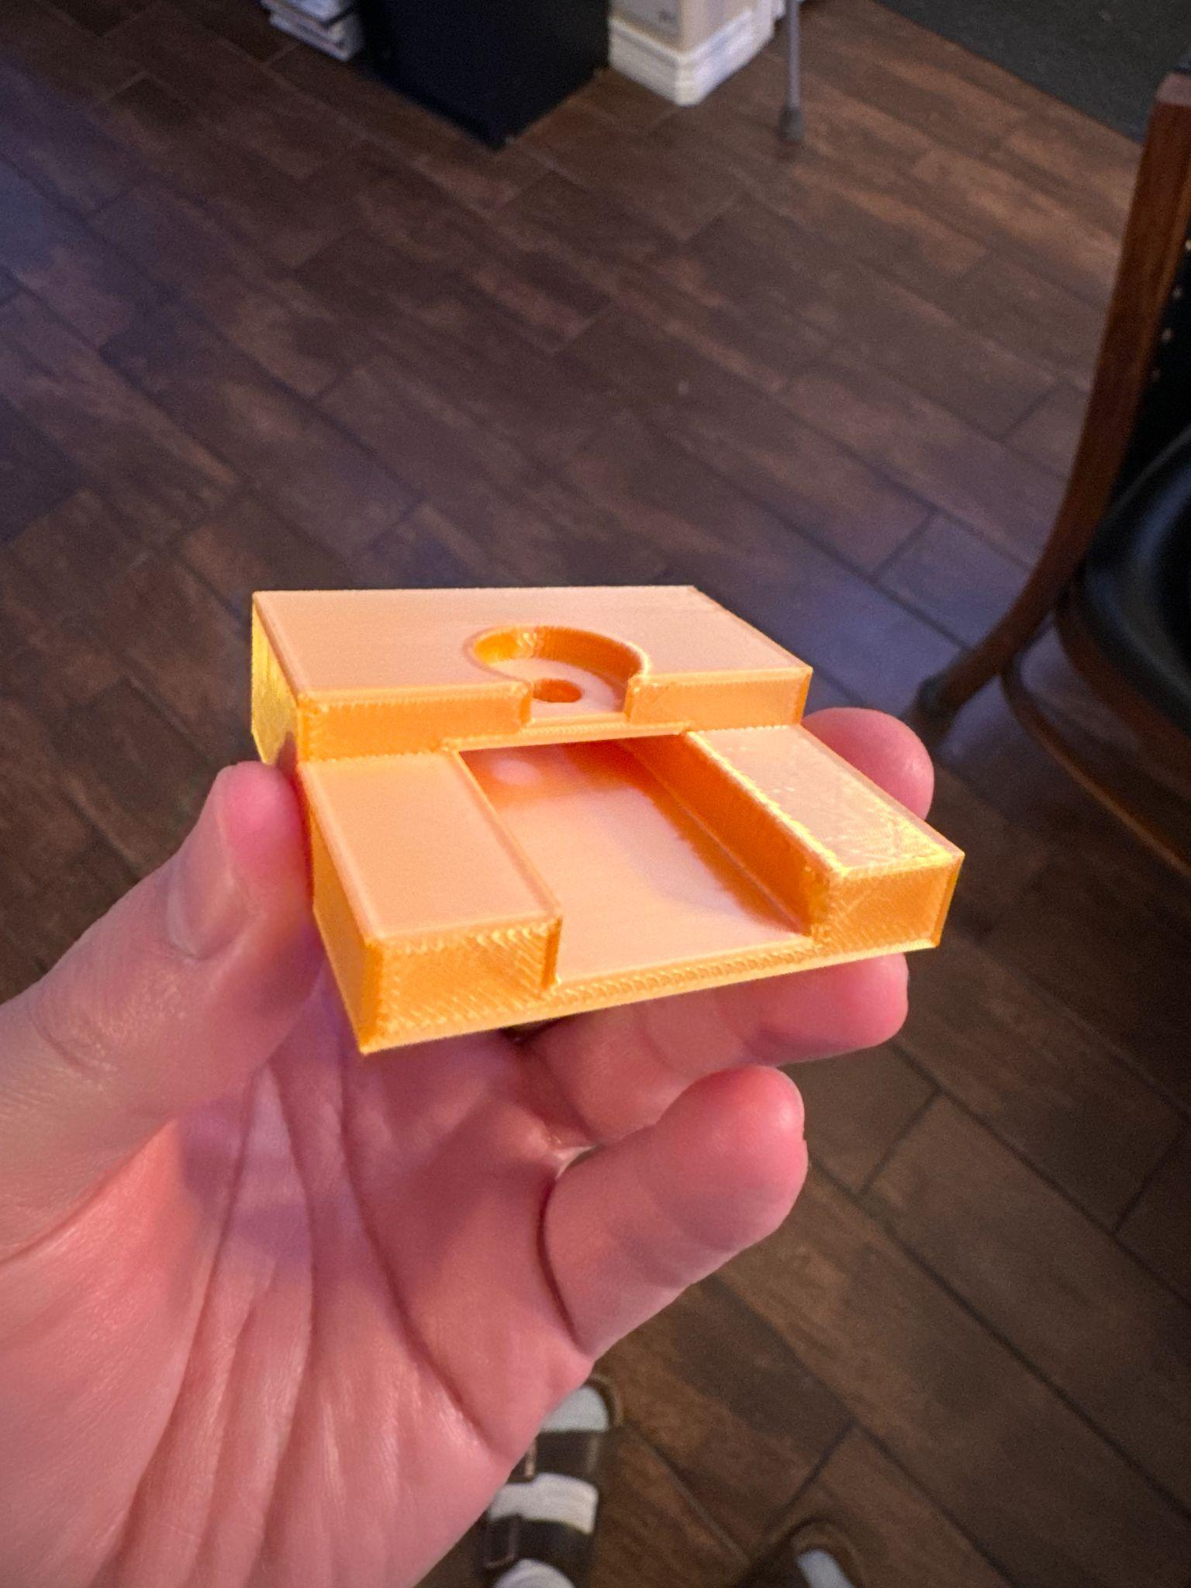
Motor Bracket
Mount onto the top screw holes of the actuator
Motor slots into the top of the mount with the axel faced down.
Band will come into through the slide slot to spin the motor axle.

Slide 5
Pressurized Air
FEDC station has a pressurized air outlet above our table supplying 80 psi air.
Air is currently down for maintenance but should be working again soon
Will need an arrestor & solenoid to safely operate the pneumatic actuator (From Bray)

Slide 6
Materials Update
Motor, potentiometers, magnets, and raspberry PI arrived.
Ordered hall effect sensor, motor shaft attachment and gear band, and wire connectors.
Cylindrical strain gauge is sourced (HBK Sensors), they’re sending a quote & will be ordered this week
Bray sending A6 actuator, and drawing files for ball valve, and valve repair kit

Slide 7
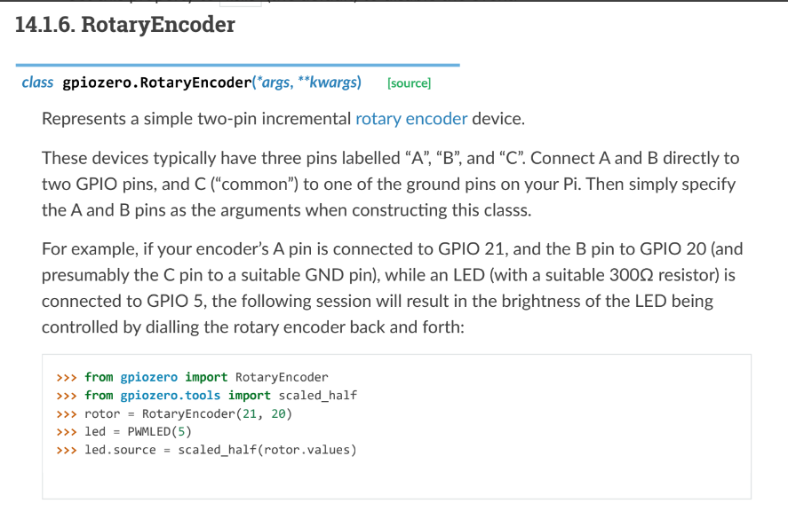
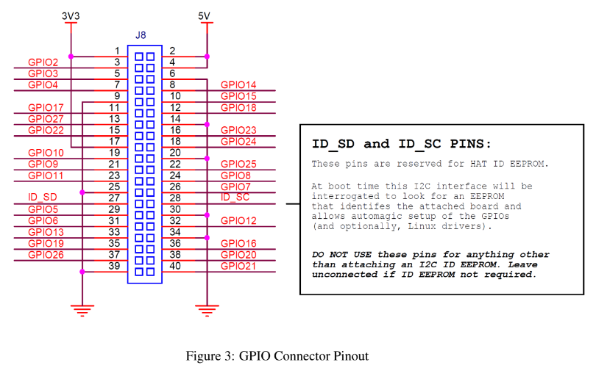
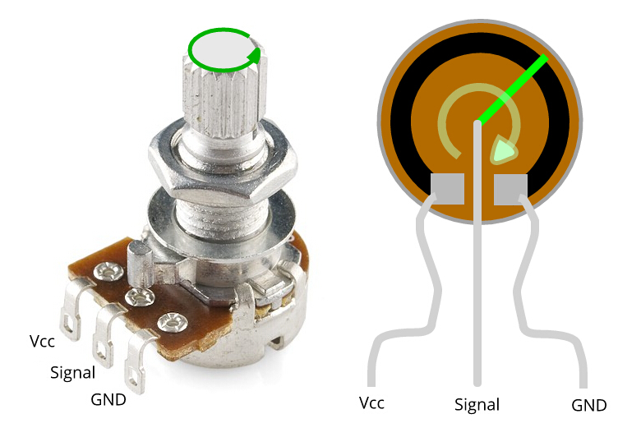
Data Analysis

Slide 8
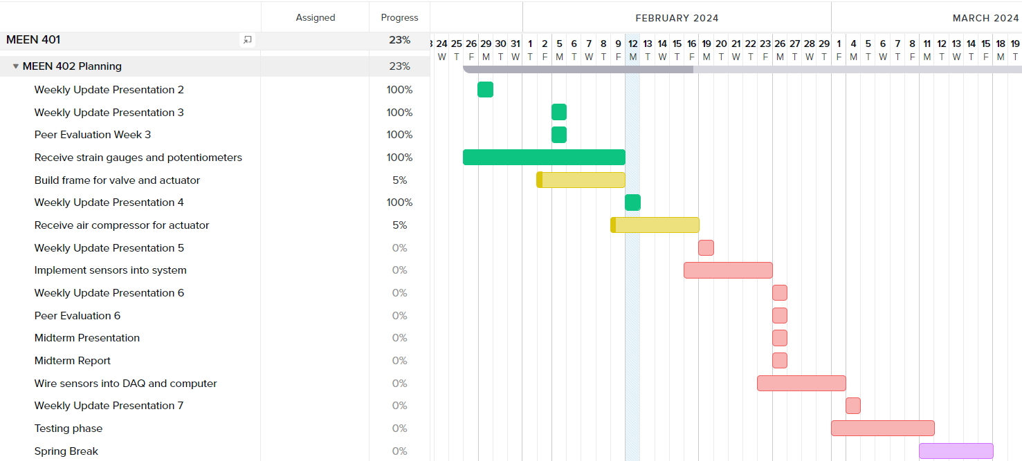
Gantt Chart

Slide 9
Next Week's Deliverables
Tasks | Lead | Percentage Done | Notes
Test sensor setup with valves and actuators | Cody/Travis | 40% | Most supplies arrived. Assist in creating test plan and execute.
Build frame for valve and actuator | Zack/Michael | 5% | Start building frame for when parts arrive for testing.
Purchase remaining parts | Avery | 25% | Have talked with Bray, will do a final run through to see if we need to order anything else

